Slide 1
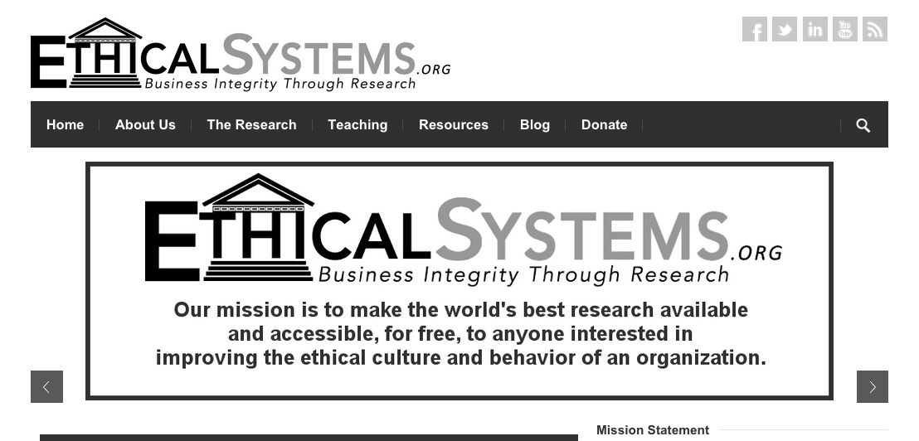
What is Ethical Systems?
Jonathan Haidt

Slide 2
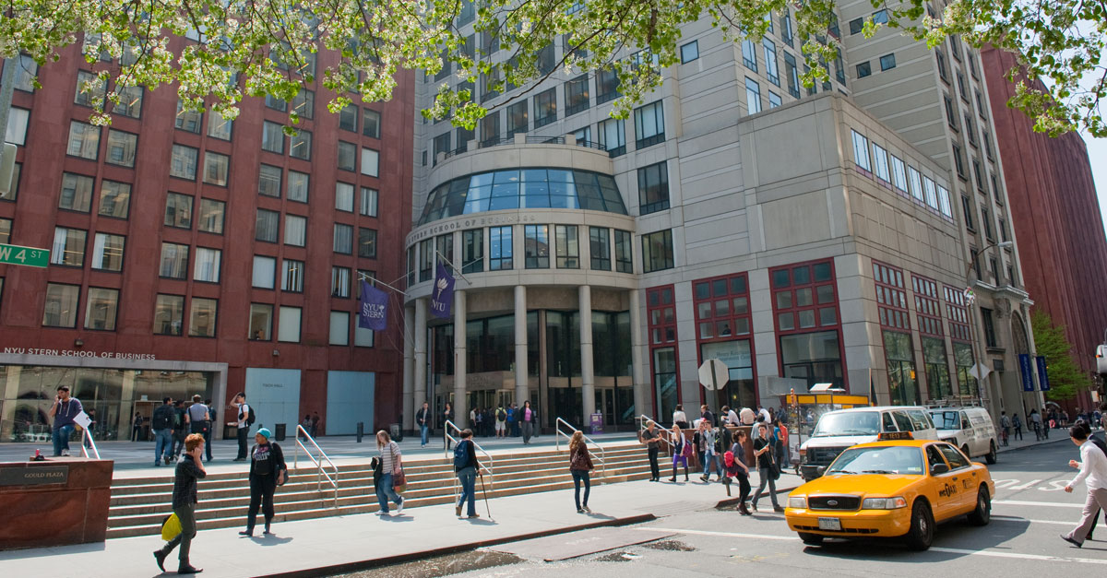

Slide 3
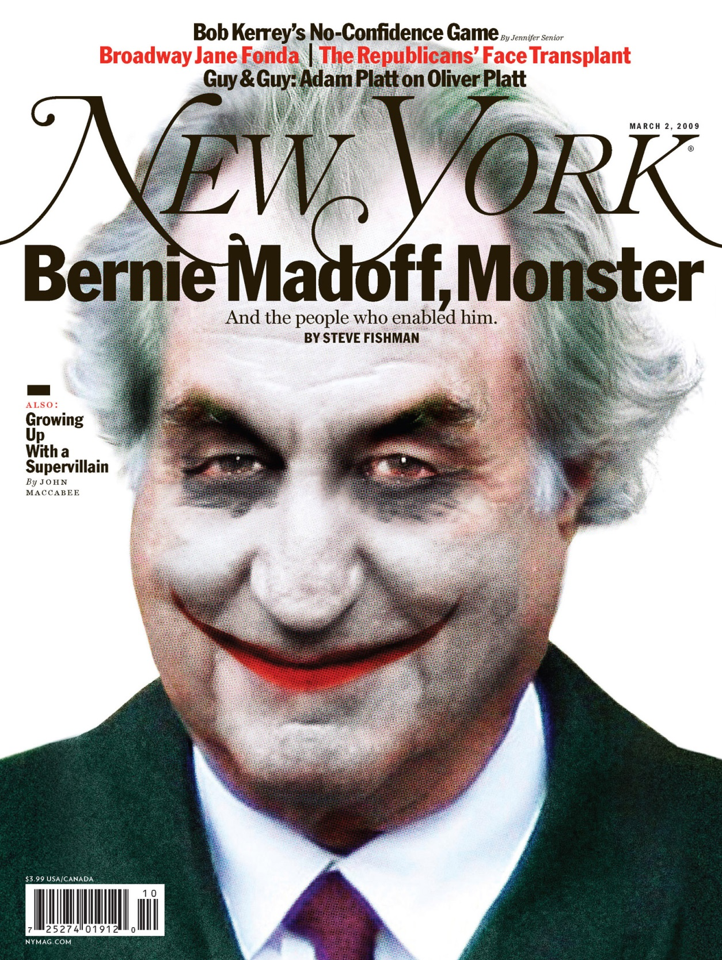
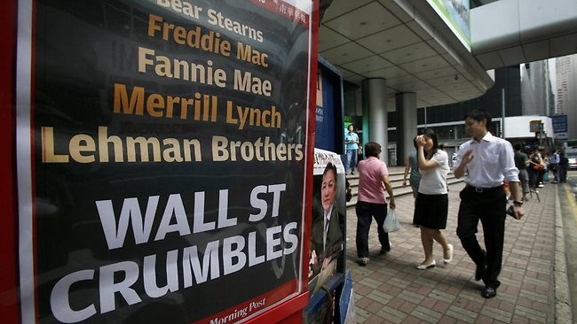

Slide 4
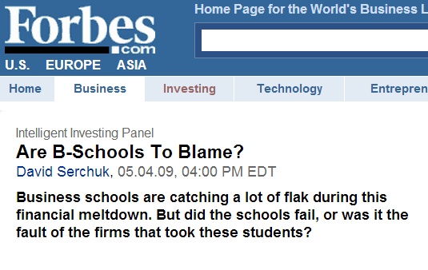
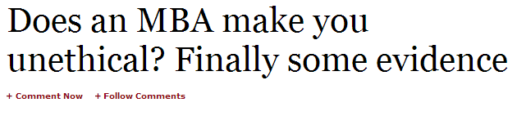

Slide 5
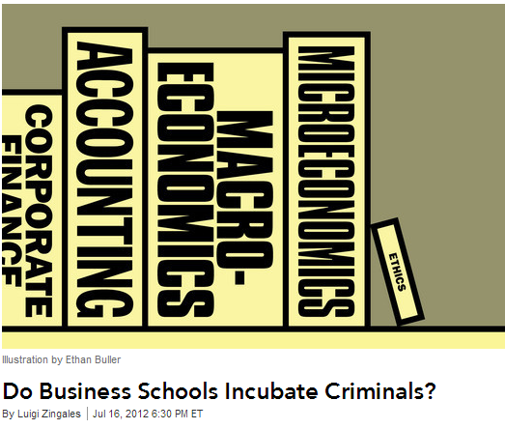

Slide 6
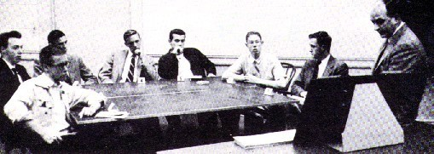
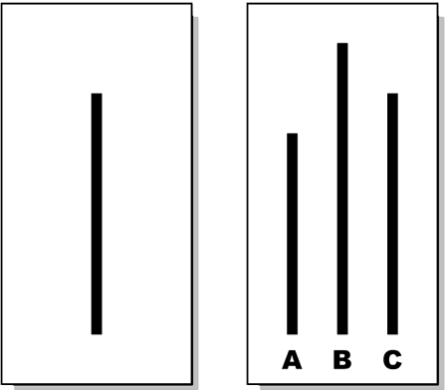
Solomon Asch: Conformity

Slide 7
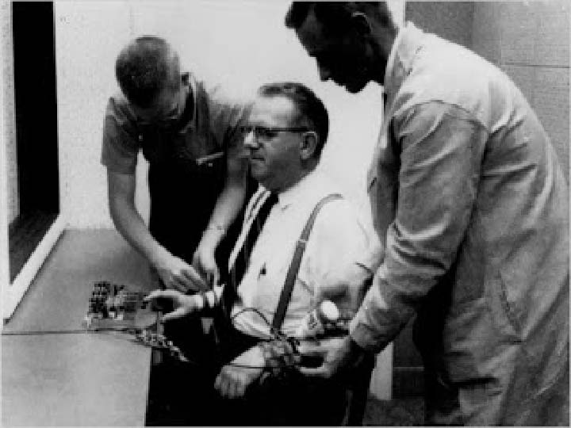
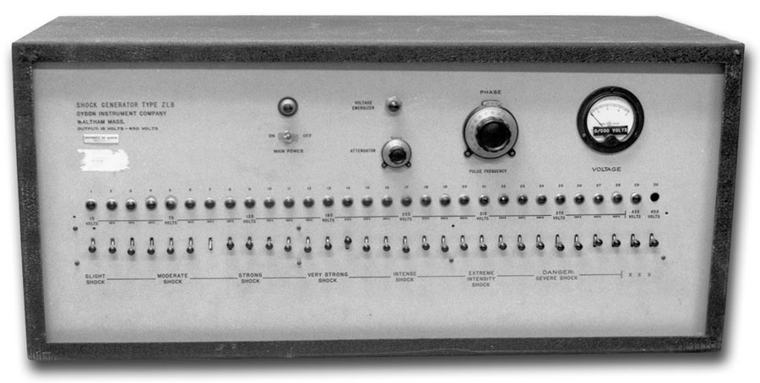
Stanley Milgram: Obedience to authority

Slide 8
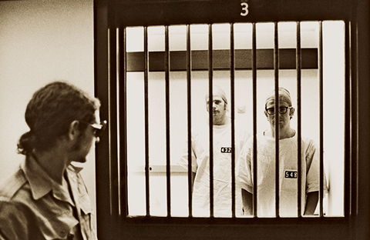
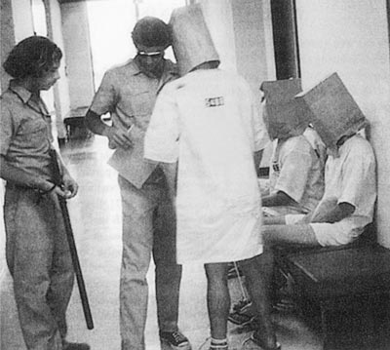
Phil Zimbardo: The Stanford Prison Study

Slide 9



Slide 10

Accounting
Dodd-Frank
Compliance Programs
Human rights
Leadership
Corporate governance
CSR
Whistle blowing
Pay and promotion
Sarbanes-Oxley
Culture
Marketing
Sentencing guidelines

Slide 12
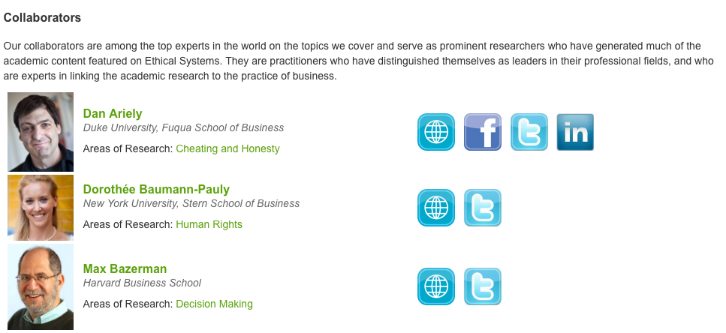

Slide 13
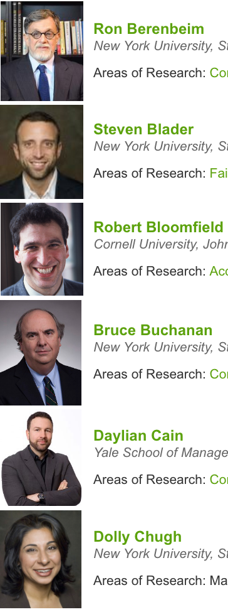
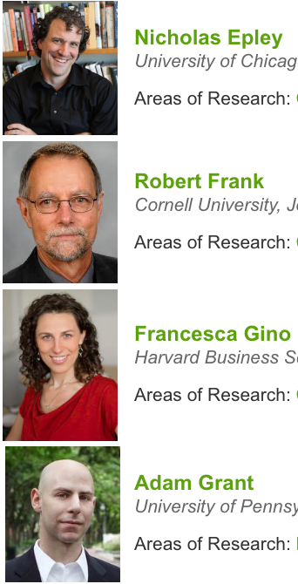
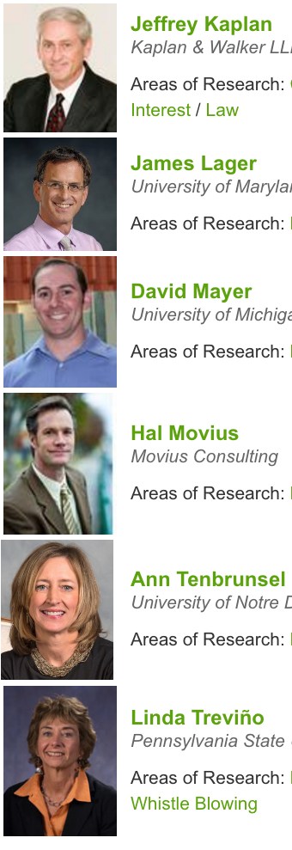
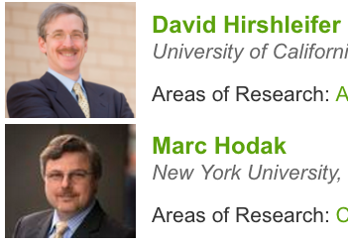

Slide 14
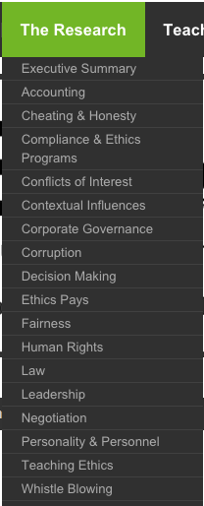
Leadership

Slide 15
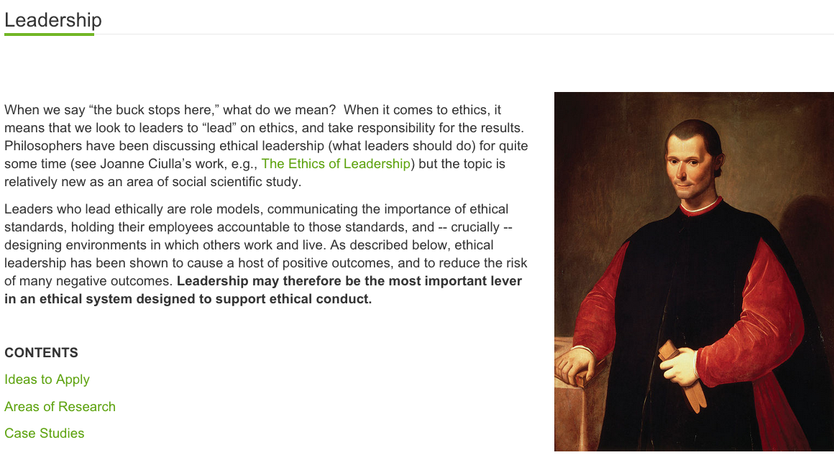

Slide 16
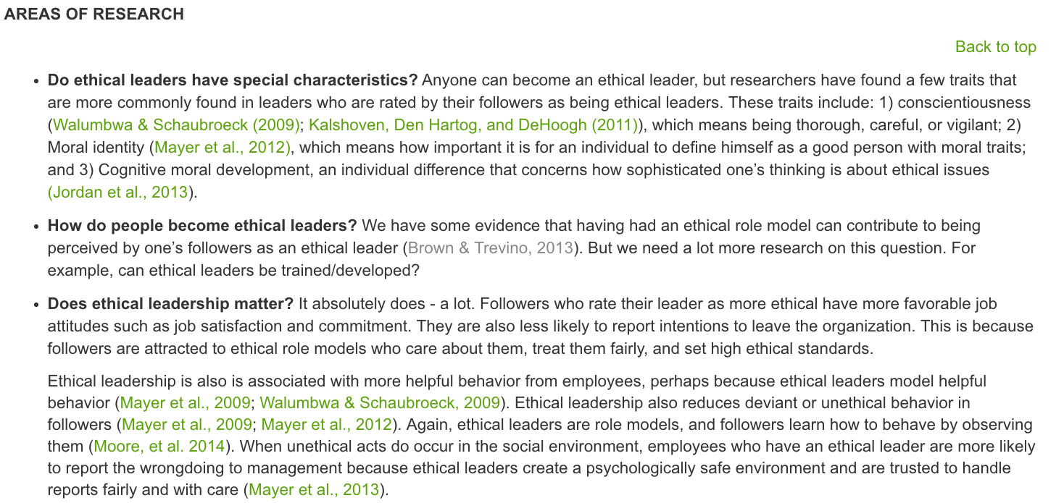

Slide 17
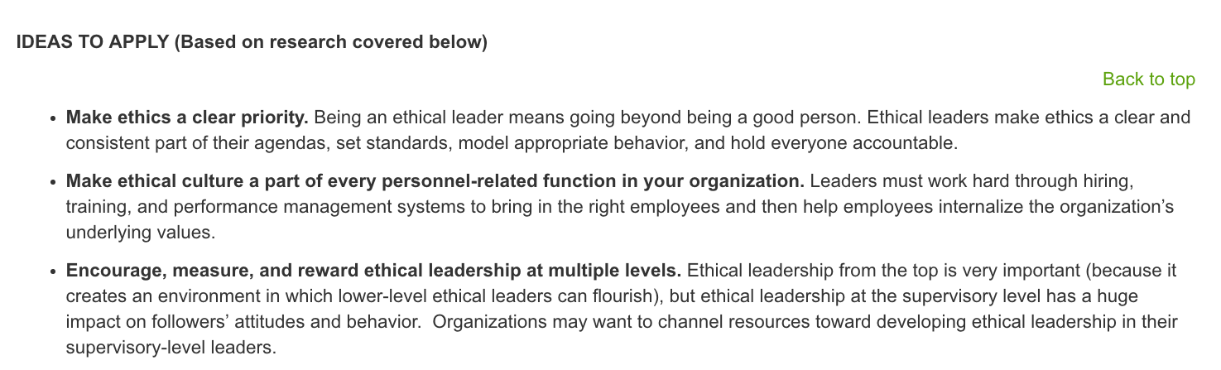
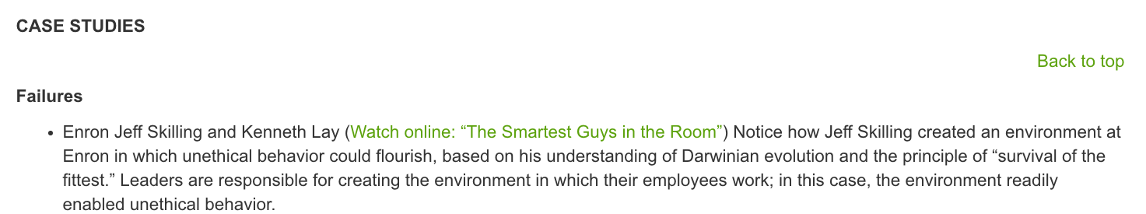
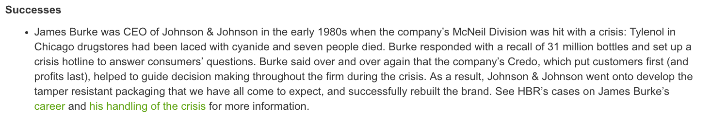

Slide 18
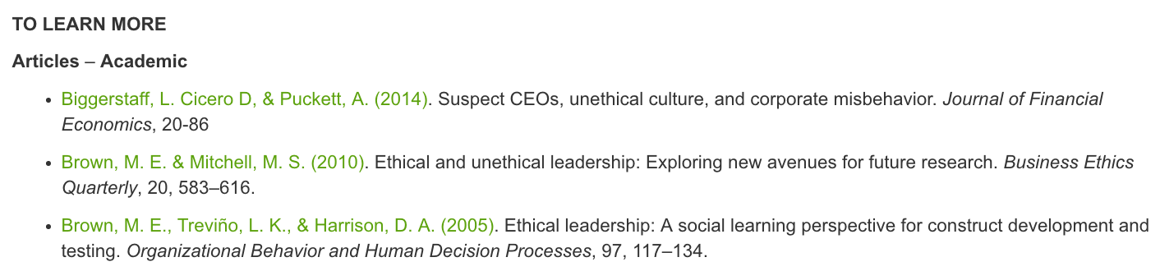
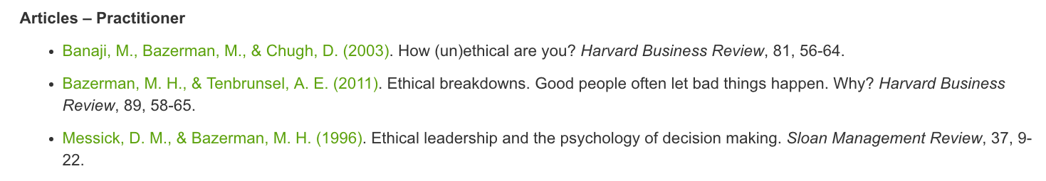
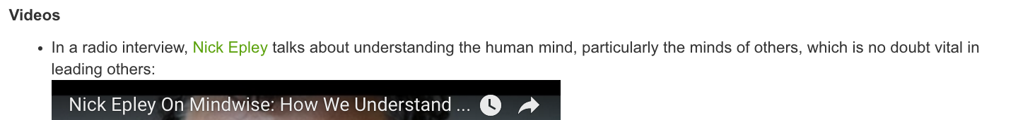

Slide 19
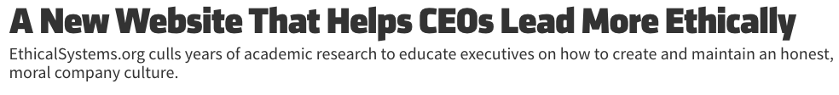

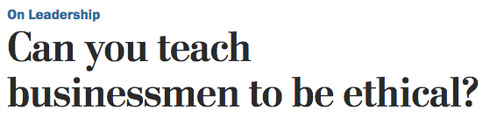

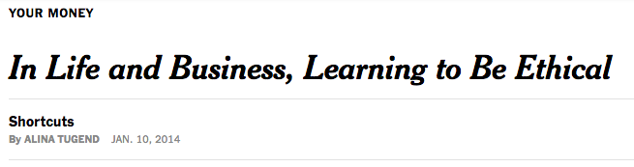
Official launch: January 2014

Slide 20
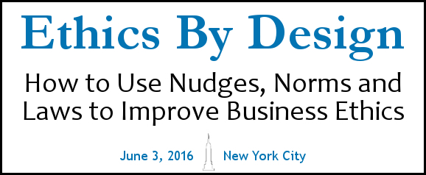
Key Insight:
You must work at
3 levels of analysis
simultaneously!

Slide 21
Ethical Systems Design: 3 levels of analysis
1: Individuals
--Nudges to increase honesty

Slide 22
Ethical Systems Design: 3 levels of analysis
2: Groups
--Norms, Ethical culture
1: Individuals
--Nudges to increase honesty

Slide 23
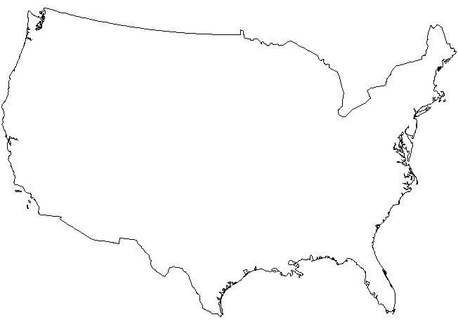
Ethical Systems Design: 3 levels of analysis
3: National &
International
Ecosystem
--Laws, national
cultures, investors
2: Groups
--Norms, Ethical culture
1: Individuals
--Nudges to increase honesty

Slide 24
Our Plan to Improve Business Ethics
Phase 1: 2014-2015: Organize existing research, make it accessible.
Phase 2: 2016-2017: Develop key partnerships; Define and measure ethical culture;
Widespread adoption of our tools.
Phase 3: 2017+: Change the ecosystems of business

Slide 25
Change the Ecosystems?
1) Enable stakeholders (esp. regulators) to reward E, not just C. (Improve the quality and reduce the cost of ethics assessments and interventions)
2) Make business ethics an experimental science (With A/B testing, data sharing, “city lab”)
3) Transform MBA curriculum
(Emphasize ethics, and ethical systems design)

Slide 27
Ethical Systems Design
Ethical Leaders?

Slide 28
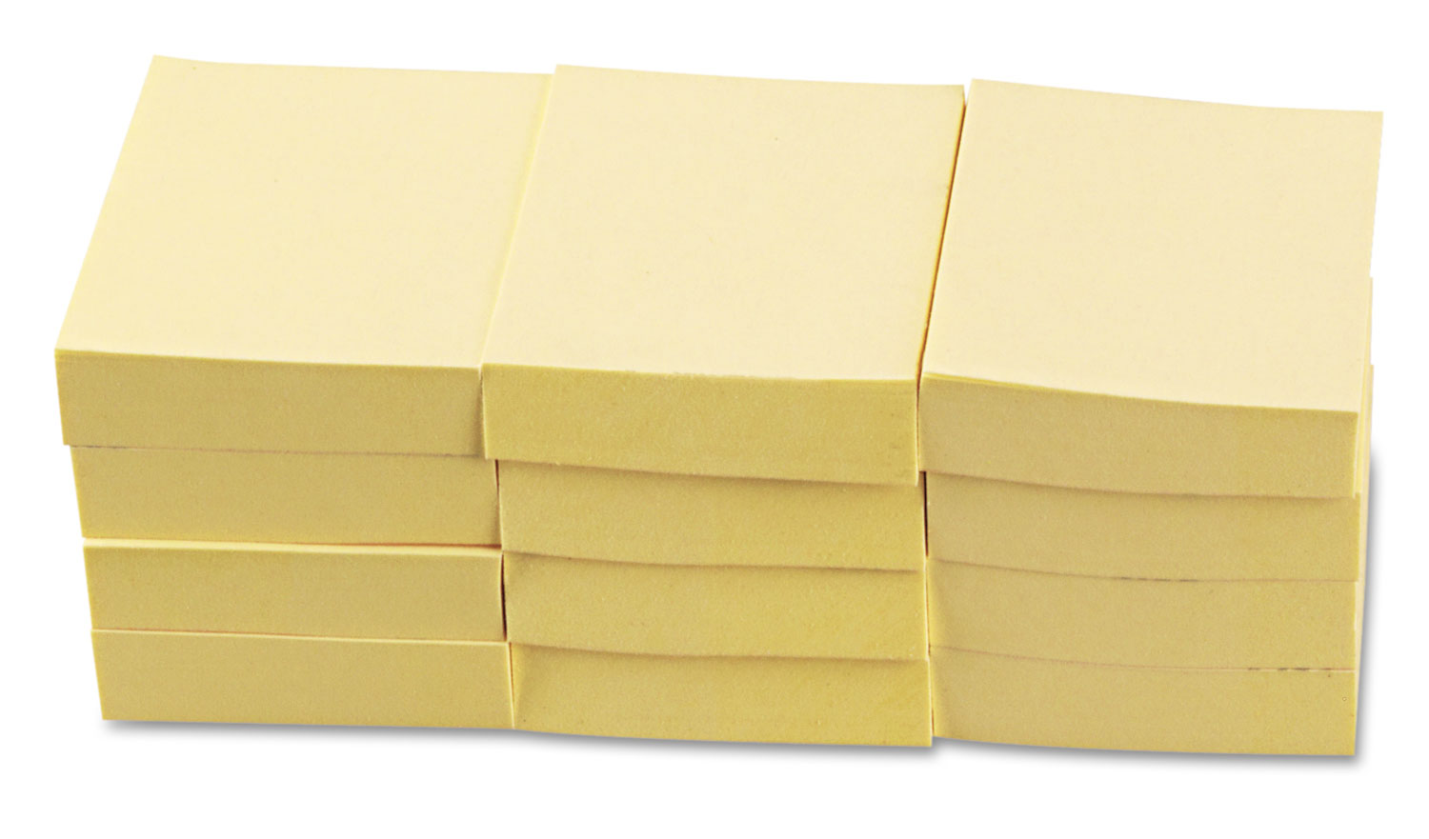
Goals for today: 1) learn from each other, 2) Grow the field, 3) Develop an agenda
Insights:
E.g., ways to use behavioral research to improve ethics
Business
Leaders
Researchers
Regulators
Questions:
E.g., Gaps & needs?

Slide 30
Themes of the day
1) Complementarity
2) Power of the social environment
3) Ethical leadership
4) Common sense is sometimes wrong
5) Assess and praise the good; assume people are good. (But verify)

Slide 31
The Future of Business Ethics, in 2026
--Business case for ethics is widely accepted
--Business case is even stronger – we have changed the ecosystem so that ethics pays even better than today
--Ethical systems design is easy, cheap, and common
--Academics & companies work much more closely
--Companies become learning orgs, about ethics
--Regulators bless companies and industries; step back

Slide 32
The Future of Business Ethics, in 2026
Your vision?
And what do we need to do to get there?

Slide 33
Small Business
Banks
Big Business
Enron
GFC

Slide 34
Small Business
Banks
Big Business
Enron
GFC

