Slide 1
Beyond Carrots and Sticks: Encouraging a Speak Up Culture
Elizabeth Wolfe Morrison, New York University
Sean R. Martin, Boston College
Ethics By Design Conference
June 3, 2016
Notes:
We’ve been asked to speak about how to create a workplace culture that encourages speaking up about ethical issues.
To address this question, we need to understand the psychology of employee voice and silence

Slide 2
Speaking Up (Employee Voice)
Informal and discretionary communication of ideas, suggestions, concerns, information about problems, or opinions about work-related issues to persons who might be able to take appropriate action
  (Detert & Burris, 2007; Morrison, 2014; Tangirala & Ramanujam, 2008; Van Dyne & LePine, 1998)

Slide 3
Importance of Employee Voice
Better decision making
Voice
Ability to adapt, improve, learn
Avoidance of major problems
Notes:
Groups make better decisions when “minority” viewpoints are expressed
Accurate and timely feedback is critical for identifying and correcting problems, and is necessary for learning and improvement
Voice is critical for avoiding major problems
Failure to voice (and cultures of silence) has been implicated in a number of deadly organizational errors (GM, Challenger), major corporate scandals (Enron, Worldcom), and catastrophic accidents (BP)

Slide 4
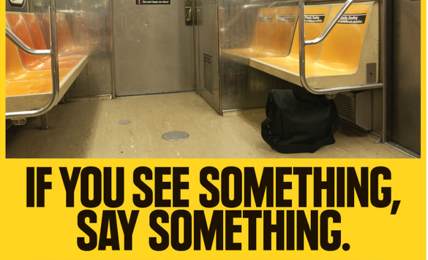
Notes:
A simple idea.
But in a work context, it is not always so simple.
Employees “see” things all the time, but they do not necessarily say anything to individuals within their organization who might be able to take action.

Slide 5
People Often Don’t Speak Up
  In a study of employees from 22 diverse organizations, 70% reported feeling afraid to speak up about certain issues (Ryan & Oestreich, 1991)
  In a study of 40 early-career professionals, 85% felt they could not speak up about one or more issues of concern: including ethical issues (Milliken, Morrison, & Hewlin, 2003)
  Fewer than 10% of health care professionals confront their colleagues when they become aware of poor clinical judgment (Souba et al., 2011)
  Research suggests that only about half of all employees who observe wrongdoing report it (Miceli et al., 2008)
  Lower status employees particularly likely to remain silent (Morrison, See & Pan, 2014)

Slide 6
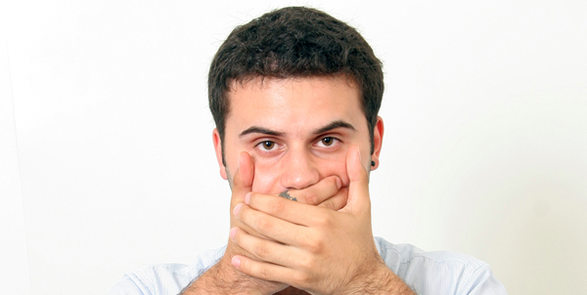
The Psychology of Silence
Futility
Fear
Employees need to feel that speaking up is psychologically safe and worth the effort

Slide 7
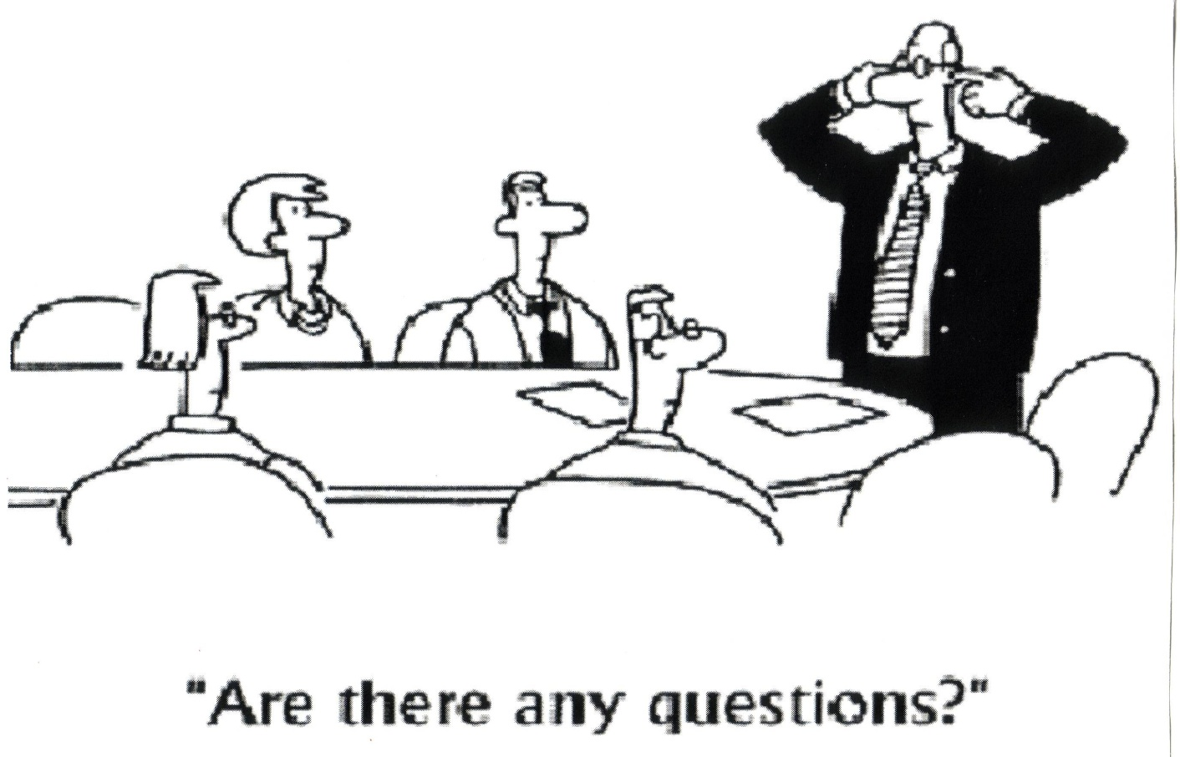
Futility: It’s not worth the effort -- No one wants to hear it

Slide 8
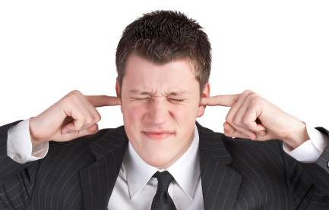
“Deaf Ear Syndrome”
It is hard for managers to be open and responsive to negative information
Threat
Overload
Beliefs
Notes:
Has been labelled “Deaf Ear Syndrome”
Negative information is threatening
Managers often feel bombarded with issues and problems
Evidence that confidence reduces advice taking and openness to input

Slide 9
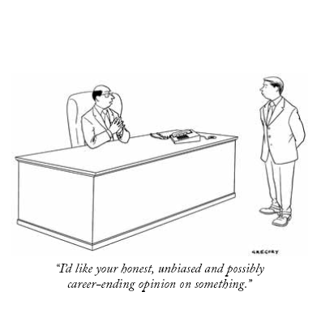
Fear: Speaking up is Dangerous

Slide 10

The Many Types of Fear
Retaliation
Negative Image
Career Consequences
Negative Labels
Damaged Relationships
Harm to Others
Notes:
When it comes to speaking up about ethical issues, all of these are potentially relevant -- esp. retaliation and career consequences

Slide 11
Fear of Punishment
“I was not comfortable confronting either Mr. Skilling
or Mr. Fastow with my concerns. To do so, I believe, would have been a job-terminating move.”
(Sherron Watkins, New York Times, 2/15/02)
“Managers would take mental notes and …would hold it against you...You had to watch what you said. If you did an okay job and never said anything controversial, you would move up.”
(female chemist, Milliken et al., 2003)

Slide 12
Are These Fears Justified?
They may be…
  People who speak up about moral issues can be seen as less warm and friendly than those who comply with ethically questionable practices (Wellman, Mayer, Ong & DeRue, in press)
  Managers often don’t like people who speak up about problems (Burris, 2012)
  Peers may respond even less positively when women speak up (McClean, Martin, Emich & Woodruff, under review)

Slide 13
Are Image Fears Justified?
But sometimes they may not be…
Follow-up Question | Response
“Do you know of anyone who has ever lost their job because they spoke up?” | “Everyone knows that we never fire anybody. I’ve never seen it happen.”
“Has anything ever happened for asking hard questions?” | “Nothing whatsoever. Nothing happens to anybody for asking any questions.”
Notes:
Data re from interviews in a large pharmaceutical company

Slide 14

Where do Voice-Inhibiting Beliefs and Fears Come From?
Work Environment
(boss, culture, group climate)
Implicit Theories and Mental Schemas

Slide 15
Implicit Theories and Schemas
  Deeply seated beliefs about authority and dissent that have little to do with the realities of the current context (Detert & Edmondson, 2011; Kish-Gephart, Detert, Trevino & Edmondson, 2009)
    e.g. It’s dangerous to challenge a superior
  Hard-wired (evolution) and learned (early socialization)
  Resistant to change
  Org. context needs to override them
Notes:
We have come to realize that often people remain silent not because of anything they have experienced or observed, but as a result of deeply seated beliefs about challenging authority and expressing disagreement
We have evolved to be vigilant and self-protective in the face of higher status others
Implicit theories about challenging authority also get shaped throughout peoples’ lives, starting well before they enter the workforce
Parents, teachers, stories, religious leaders reinforce the belief that one should obey rather than challenge authority figures.
As with many deeply seated beliefs and habits, once formed, they tend to endure (even in face of contradictory evidence)

Slide 16
Common Approaches to Encouraging Voice
Suggestion boxes
Anonymous reporting hotlines
But these channels do not necessarily create a culture where employees feel that speaking up is welcomed or safe
Notes:
So what do organizations do to try to encourage employee voice?
Leaders must also create a context that addresses the deeply seated fears and concerns

Slide 17
Ways of Generating Voice
A study of several thousand people working in credit unions throughout the Southwest
Leader Behaviors | Correlation ( r )
Active solicitation | .47
Follow-up behaviors | .34
Managerial openness | .30
Informal mechanisms | .31
Formal mechanisms | .08
Notes:
In this instance, the formal mechanisms were things like anonymous suggestion boxes, hotlines etc.
Informal mechanisms are things like a short huddle before the business day starts, having more casual interactions with followers.
Leaders must also create a context that addresses the deeply seated fears and concerns

Slide 18
Fostering Speaking Up: The Importance of Leadership
Leadership Style
Transformational Leadership
Leader
Openness
Individualized consideration, inspirational motivation, trust
Approachability, receptiveness to input
Ethical Leadership
Modelling ethical conduct, discussing ethical issues
Notes:
Leadership Style matters a lot
Key mediator: Psych Safety!

Slide 19
Fostering Speaking Up: The Importance of Leadership
Leader Behaviors
Consultation
Follow Up
Acknowledging Fallibility
Reducing Power
Differences
Notes:
Specific behaviors are important too
Culture is rooted in behaviors, and these are some of the behaviors most likely to help foster a culture that supports voice

Slide 20
WHAT ABOUT ETHICAL VOICE?

Slide 21
Types of Voice
Promotive Voice
  Speaking up with an idea or improvement-oriented suggestion for change
Prohibitive Voice
  Pointing out a problem of potentially harmful practice that should be stopped
Ethical Voice
  Speaking up about an ethically questionable or problematic issue

Slide 22
Types of Voice
Is speaking up about ethical issues different?
  We have surprising little information about this
How does what we know about other types of voice apply to ethical voice?
  We need more data
  So here’s some basic descriptive data…

Slide 23
Types of Voice
I gathered 69 responses from an online sample
I asked them to rank the different types of voice according to
  How easy each type seems
  How scary each type seems
  How potentially hurtful to others
  How likely to make you look bad
  How confident you would be doing it

Slide 24
Types of Voice
**
**
Notes:
I obtained z-scores for the percentage differences compared to a uniform distribution in order to check for significant differences.

Slide 25
Types of Voice
**
**
Notes:
Insert each box one at a time with an animation

Slide 26
Types of Voice
**
Notes:
Insert each box one at a time with an animation

Slide 27
Types of Voice
**
**
Notes:
Insert each box one at a time with an animation

Slide 28
Types of Voice
**
*
Notes:
Insert each box one at a time with an animation

Slide 29
Types of Voice
Ethical voice – anecdotally, at least – seems to be the LEAST EASY type to do
It seems to be the SCARIEST
People might feel the LEAST CONFIDENT doing it
Like with pointing out problems, people worry more about HURTING OTHERS and LOOKING BAD themselves
Notes:
Insert each box one at a time with an animation

Slide 30
Very New Courage Research (Detert)
Inductively generated 35 different behaviors that require courage at work
  6 of those behaviors explicitly concerned speaking up about or taking action on ethical issues
Over 700 respondents rated those 35 behaviors in terms of the courage they require
  All 6 of the ethical behaviors all appeared in the top 10 behaviors requiring the most courage
  All 6 also appear in the top 10 of least frequently observed

Slide 31
How Does What We Know Apply?
A second study with online respondents (n=156), assigned to one of three conditions
  Rating how frequently they
    Have ideas (Condition 1)
    Notice problems (Condition 2)
    Notice ethically questionable issues or practices (Condition 3)
  They rated whether they speak up with voice of the kind featured in their condition
  They rated their boss and work context on voice related variables as well as a variable I created to capture “fear”

Slide 32
How Does What We Know Apply?
Do people speak up when they have ideas, notice problems, or spot ethical issues?
**
ns
1 – 7 Scale: higher =more voice

Slide 33
How Does What We Know Apply?
How frequently do people even have ideas, notice problems, or spot ethical issues?
**
ns
1 = Never; 5=All of the time

Slide 34
How Does What We Know Apply?
Can you clearly recall the last time you had an idea/noticed a problem/noticed an ethical issue?
  “no’s” were removed
*
**
ns

Slide 35
How Does What We Know Apply?
(Relationship strengths between classic factors and different types of voice)
What influences speaking up?
How does it relate to what is being raised?
Analyzed by leader and contextual influences

Slide 36
Leadership Influences
(Relationship strengths between classic factors and different types of voice)
Ethical Leadership to Voice
Promotive | Prohibitive | Ethical
.49** | .51** | .41**
Transformational Leadership to Voice
Promotive | Prohibitive | Ethical
.57** | .49** | .41**
Leader Soliciting to Voice
Promotive | Prohibitive | Ethical
.58** | .58** | .54**
Leader Openness to Voice
Promotive | Prohibitive | Ethical
.54** | .49** | .39**
Humble Leadership to Voice
Promotive | Prohibitive | Ethical
.41** | .56** | .50**
No significant differences

Slide 37
Contextual Influences
(Relationship strengths between classic factors and different types of voice)
Futility to Voice
Promotive | Prohibitive | Ethical
-.62** | -.64** | -.50**
No significant difference
Psychological Safety to Voice
Promotive | Prohibitive | Ethical
.32* | .71** | .38**
Significant differences
Promotive-Prohibitive | Promotive-Ethical | Prohibitive-Ethical
** | ns | **

Slide 38
Applying Lessons
Ethical voice is similar to other types of voice in some ways
We can apply lessons from prior research
  Training regarding leadership behaviors
  Active solicitation in addition to passive approaches
  Don’t just put the onus on followers
  Perceived safety among one’s group

Slide 39
Applying Lessons
Ethical voice does seem to be different in some ways from other types of employee voice
  It appears scarier to do
  Most likely to make one look bad
  Requires a HUGE amount of courage
  People are much less confident about it
Perhaps we could begin addressing not only the access and channels for voice, but the fear and low confidence that people harbor
Notes:
I highlight the confidence because I believe that is an area where we can stimulate rich discussion about how to get people to share barely formed, ambiguous information. That’s tough, and I don’t know that we have a good understanding of how to do that.

Slide 40
Encouraging Speaking Up
Leader Behaviors
Consultation
Follow-up
Humility
Reducing Power
Differences
Soliciting Information
Taking Timely Action
Acknowledging Fallibility
Avoiding Hierarchy Triggers
But!
Much more information is needed if we really want to encourage ethical voice
Notes:
Specific behaviors are important too
What sorts of behaviors should be encouraged?
How do you get people to speak up about amorphous ideas like ethics? Especially given that people were far less confidence about speaking up regarding ethical issues? Connect to the IVTs that you should only speak up when you have data.

Slide 41
THANK YOU

Slide 42
APPENDIX/ADDITIONAL SLIDES

Slide 43
Full Ranking Data
Easy | % Ranking 1st | % Ranking 2nd | % Ranking 3rd
Promotive Voice | 57 | 34 | 15
Prohibitive Voice | 32 | 35 | 27
Ethical Voice | 11 | 31 | 58
Scary | % Ranking 1st | % Ranking 2nd | % Ranking 3rd
Promotive Voice | 9 | 27 | 60
Prohibitive Voice | 32 | 47 | 22
Ethical Voice | 58 | 24 | 16
Hurtful to others | % Ranking 1st | % Ranking 2nd | % Ranking 3rd
Promotive Voice | 6 | 14 | 79
Prohibitive Voice | 47 | 40 | 16
Ethical Voice | 47 | 47 | 5
Make me look bad | % Ranking 1st | % Ranking 2nd | % Ranking 3rd
Promotive Voice | 14 | 21 | 62
Prohibitive Voice | 35 | 41 | 22
Ethical Voice | 51 | 38 | 16
Confidence about | % Ranking 1st | % Ranking 2nd | % Ranking 3rd
Promotive Voice | 63 | 28 | 14
Prohibitive Voice | 25 | 30 | 40
Ethical Voice | 12 | 42 | 46

